Slide 1


EE-351 COMMUNICATION NETWORKS
END SEMESTER PROJECT
Group Members:
Danial Ahmad
Muhammad Ahmed Mohsin
Muhammed Umer
Syeda Fatima Zahra

Slide 2

NOMA AND OFDMA-ASSISTED WIRELESS NETWORKS:
A COMPARATIVE ANALYSIS
01
02
03
04
Introduction
OFDMA Assisted Networks
NOMA Assisted Networks
SIC
05
06
07
08
Implementation
Simulation and Results
Future Prospects
Questions

Slide 3

INTRODUCTION
Multiple Access Schemes
Increase in Mobile Traffic
Performance Parameters
Simulation Model of 4 Users
Exhaustive Looping Technique
Performance Analysis

Slide 4
Orthogonal Frequency Division Multiple Access (OFDMA)
Shares time and frequency resources
Divides bandwidth into narrowband subcarriers
Heightened spectral efficiency
Enhanced performance in challenging environments
Widely used in Wi-Fi, LTE, and 5G
Increased implementation complexity

Slide 5

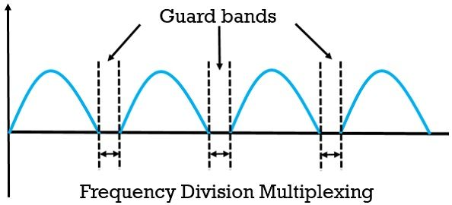
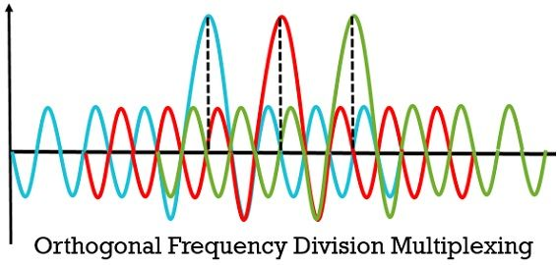

Slide 6
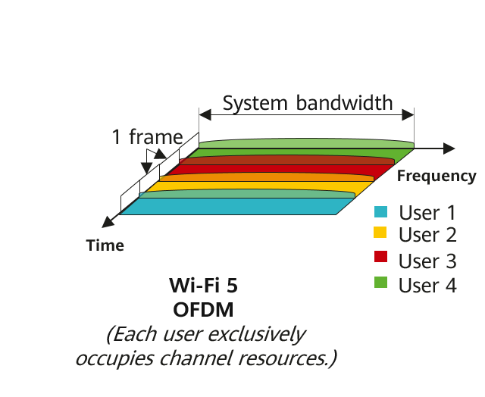
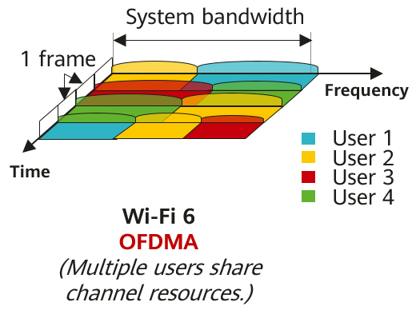
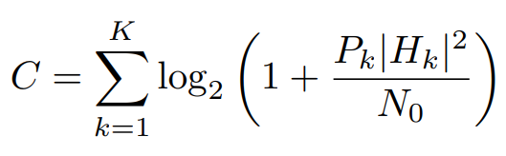
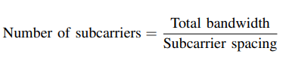
OFDMA supports simultaneous low data rate transmission from several users, but OFDM can only support one user at given moment.
OFDMA supports per channel or sub-carrier power while OFDM needs to maintain the same power for all sub-carriers.
Channel Capacity

Slide 7
Non-Orthogonal Multiple Access (NOMA)
Allocates different power levels to different users
Strategic power allocation enables efficient sharing
Outperforms OFDMA in throughput, energy efficiency, and fairness
Optimal resource allocation further improves performance
Easier to implement

Slide 8

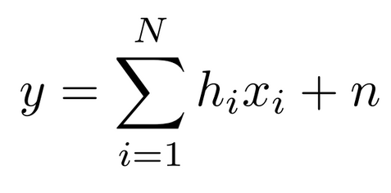
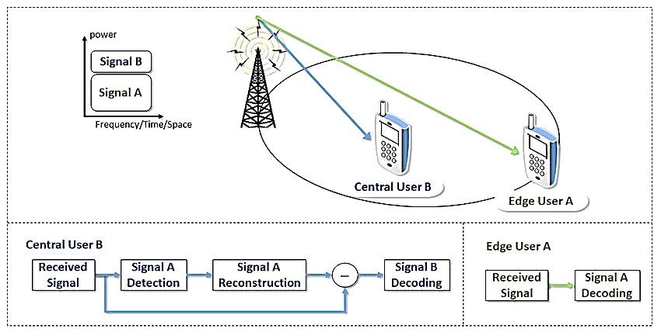
SUCCESSIVE INTERFERENCE
CANCELLATION (SIC)
Superposition Coding Equation
Technique used in NOMA systems
Enables decoding of signals from multiple users
Manages interference effectively
Decodes signals in successive stages
Cancels out interference from previously decoded signals
Improves performance and interference mitigation

Slide 9
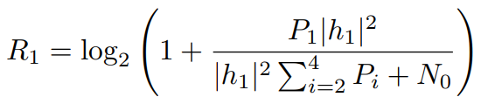
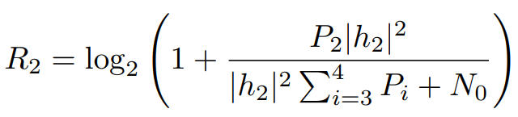
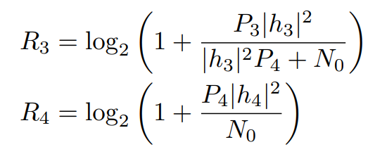
SUCCESSIVE INTERFERENCE
CANCELLATION (SIC)
Superposition Coding Equation
Technique used in NOMA systems
Enables decoding of signals from multiple users
Manages interference effectively
Decodes signals in successive stages
Cancels out interference from previously decoded signals
Improves performance and interference mitigation

Slide 10
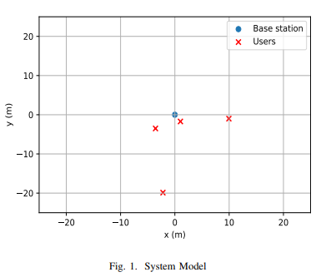
SYSTEM MODEL
Single base station and four users
Distinct channel gain for each user
Rayleigh fading channel model

Slide 11
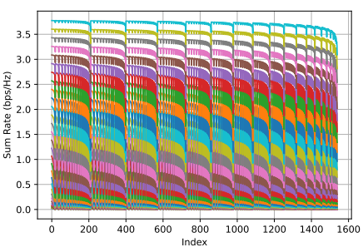
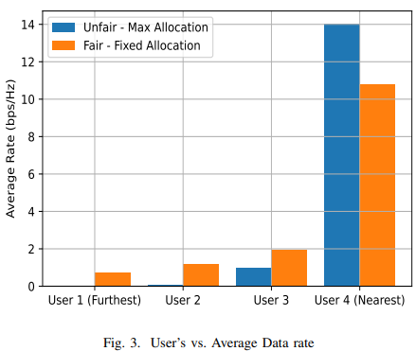
SIMULATION AND RESULTS
Exhaustive Allocation
User Unfairness

Slide 12
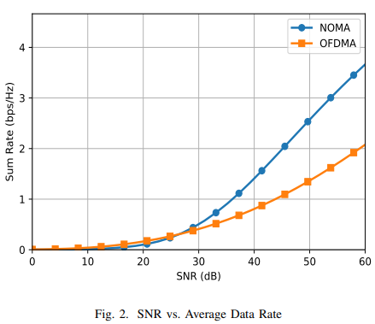
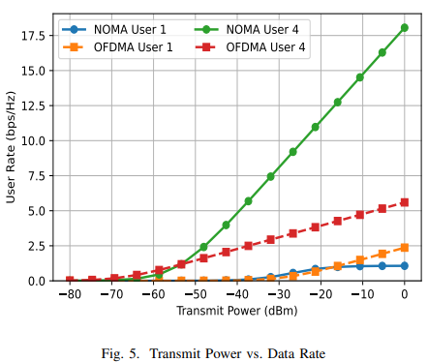
SIMULATION AND RESULTS
Improved Capacity
Saturation Problem of Far User

Slide 13

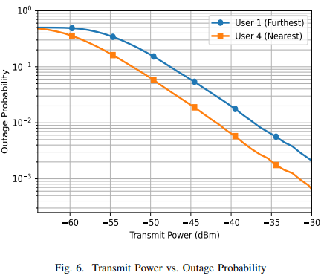
ANALYSIS
Outage Probability
Compares performance of OFDMA and NOMA
Evaluates throughput, energy efficiency, and fairness
NOMA outperforms OFDMA in all three metrics
Optimal power allocation further improves NOMA performance

Slide 14
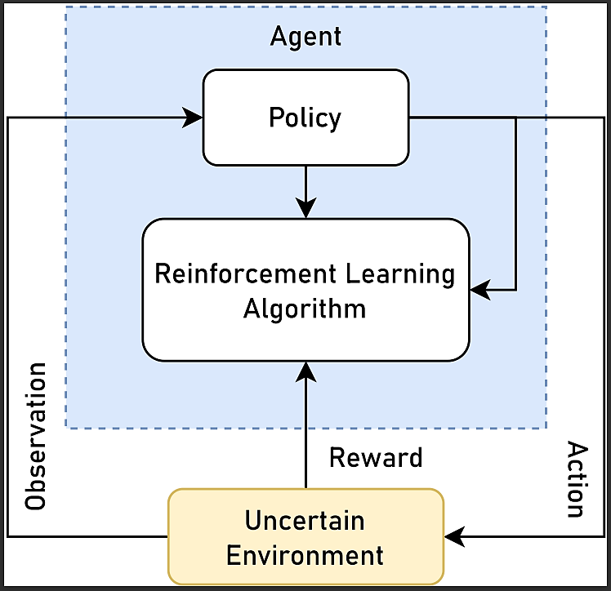
FUTURE PROSPECTS
Reinforcement learning technique proposed for optimal power sub-allocation in NOMA.
Reinforcement learning can improve performance by reducing overhead and adapting to changes in the environment.
The goal is to maximize overall system capacity and spectral efficiency

Slide 15
QUESTIONS

